Slide 1
Data Centric RAD
Bachelor of Science (Honours) in Computing in Software Development
Bachelor of Science in Computing in Software
Development
Department of Computer Science & Applied Physics

Slide 2
Review of MySQL – Data From Multiple Tables
Employee Table
eID* | eName | Next Of Kin ID
1 | Fred | 100
2 | Tom | 101
3 | Darragh | 102
4 | Sean | NULL
Display the Employee’s name and his Next of Kin’s Name – How?
Use Foreign Key(s) to link tables together to find the information.
select employee_table.ename,
next_of_kin_table.nok_name
from employee_table
Next Of Kin Table
NOK ID* | NOK Name
100 | Cathy
101 | Mary
102 | Vikki
Inner Join next_of_kin_table
on employee_table.nextofkin =
next_of_kin_table.nok_id;

Slide 3
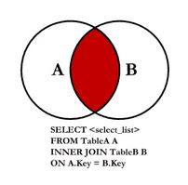
Data From Multiple Tables – Inner Join
ename | nok_name
Fred | Cathy
Tom | Mary
Darragh | Vikki
An INNER JOIN (simple join, join) returns all rows from multiple tables
where the join condition is met.
Most common Join
What’s the problem with the data returned from the Inner Join?

Slide 4
Data From Multiple Tables
Employee Table
eID* | eName | Next Of Kin ID
1 | Fred | 100
2 | Tom | 101
3 | Darragh | 102
4 | Sean | NULL
Show each Employee’s name, and if he/she has a Next of Kin, show the Next of Kin’s Name too – How?
Use Foreign Key(s) to link tables together to find the information.
select employee_table.ename,
next_of_kin_table.nok_name
from employee_table
Next Of Kin Table
NOK ID* | NOK Name
100 | Cathy
101 | Mary
102 | Vikki
Left Join next_of_kin_table
on employee_table.nextofkin =
next_of_kin_table.nok_id;

Slide 5
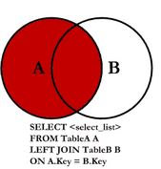
Data From Multiple Tables – Left Join
ename | nok_name
Fred | Cathy
Tom | Mary
Darragh | Vikki
Sean | NULL
A LEFT JOIN (left outer join) returns all rows from the
first (left) table,
with matching rows from the second (right) table.
If no rows match in the second table, NULL is returned

Slide 6
Data From Multiple Tables - Shorthand
Rather than typing the full table name each time, it can be abbreviated.
The abbreviated version is on the right.
select employee_table.ename,
next_of_kin_table.nok_name
from employee_table
Inner Join next_of_kin_table
on employee_table.nextofkin =
next_of_kin_table.nok_id;
select select e.ename,
k.nok_name
from employee_table e
Inner Join next_of_kin_table k
on e.NextOfKin = k.NOK_ID;

Slide 7
Data From Multiple Tables
Superhero_Table
Name* | Real_First_Name | Real_Surname | dob | powers
Batgirl | Barbara | Gordon | 1995-12-07 | 98.05
Batman | Bruce | Wayne | 1960-11-12 | 97.45
Radioactiveman | Alan | Jones | 2000-07-04 | 76.88
Spiderman | Peter | Parker | 1980-01-27 | 71.04
Superman | Clark | Kent | 1980-11-22 | 99.00
Joker | John | Jones | 1966-10-12 | 22.20
Superhero_City_Table
Name* | Id*
Batgirl | 2
Batman | 2
Batman | 3
Spiderman | 3
Superman | 3
Spiderman | 4
Radioactiveman | 5
City_Table
Id* | city_name | country | population
1 | Galway | Ireland | 75,000
2 | Gotham City | USA | 15,000,000
3 | Metropolis | USA | 22,500,000
4 | New York | USA | 8,500,000
5 | Springfield | USA | 20,000
Display the name of each superhero, the name of the city he/she lives in, and the population of that city.

Slide 8
Data From Multiple Tables
select s.name, c.city_name, c.population
from superhero_table s
Inner Join superhero_city_table sc
on s.name = sc.name
Inner Join city_table c
on sc.id = c.id;
name | city_name | population
Batgirl | Gotham City | 15000000
Batman | Gotham City | 15000000
Batman | Metropolis | 22250000
Spiderman | Metropolis | 22250000
Superman | Metropolis | 22250000
Spiderman | New York | 8500000
Radioactiveman | Springfield | 20000

Slide 9
Data From Multiple Tables
select s.name, c.city_name, c.population
from superhero_table s
LEFT Join superhero_city_table sc
on s.name = sc.name
LEFT Join city_table c
on sc.id = c.id;
name | city_name | population
Batgirl | Gotham City | 15000000
Batman | Gotham City | 15000000
Batman | Metropolis | 22250000
Spiderman | Metropolis | 22250000
Superman | Metropolis | 22250000
Spiderman | New York | 8500000
Radioactiveman | Springfield | 20000
Joker | NULL | NULL

Slide 10
Data From Multiple Tables
Superhero_Table
Name* | Real_First_Name | Real_Surname | dob | powers
Batgirl | Barbara | Gordon | 1995-12-07 | 98.05
Batman | Bruce | Wayne | 1960-11-12 | 97.45
Radioactiveman | Alan | Jones | 2000-07-04 | 76.88
Spiderman | Peter | Parker | 1980-01-27 | 71.04
Superman | Clark | Kent | 1980-11-22 | 99.00
Joker | John | Jones | 1966-10-12 | 22.20
Superhero_City_Table
Name* | Id*
Batgirl | 2
Batman | 2
Batman | 3
Spiderman | 3
Superman | 3
Spiderman | 4
Radioactiveman | 5
City_Table
Id* | city_name | country | population
1 | Galway | Ireland | 75,000
2 | Gotham City | USA | 15,000,000
3 | Metropolis | USA | 22,500,000
4 | New York | USA | 8,500,000
5 | Springfield | USA | 20,000
Display the name of ALL cities as City, and the DOBs of its superheroes as Birthdays.

Slide 11
Data From Multiple Tables
select c.city_name as 'City', s.dob as 'Birthday’
from city_table c
Inner Join superhero_city_table sc
on c.id = sc.id
Inner Join superhero_table s
on sc.name = s.name;
City | population
Galway | NULL
Gotham City | 1995-12-07
Gotham City | 1960-11-12
Metropolis | 1960-11-12
Metropolis | 1980-01-27
Metropolis | 1980-11-22
New York | 1980-01-27
Springfield | 2000-07-04

Slide 12
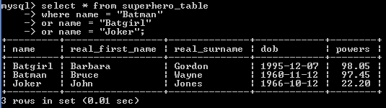
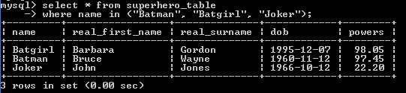
IN Clause
IN clause can be used to replace many OR conditions.

Slide 13
SubQueries
A MySQL subquery is a query that is nested inside another query such as SELECT, INSERT, UPDATE or DELETE.
A MySQL subquery can be nested inside another subquery.
SubQueries are also called Inner Queries

Slide 14
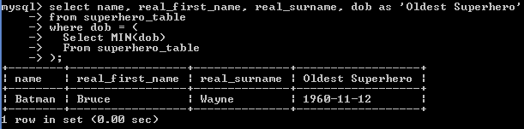
SubQueries
Superhero_Table
Name* | Real_First_Name | Real_Surname | dob | powers
Batgirl | Barbara | Gordon | 1995-12-07 | 98.05
Batman | Bruce | Wayne | 1960-11-12 | 97.45
Radioactiveman | Alan | Jones | 2000-07-04 | 76.88
Spiderman | Peter | Parker | 1980-01-27 | 71.04
Superman | Clark | Kent | 1980-11-22 | 99.00
Joker | John | Jones | 1966-10-12 | 22.20
Display the name, real first name, real surname and dob (as Oldest Superhero) of the oldest superhero.

Slide 15
SubQueries
Student_Table
Student_ID * | Student_Name | Course_ID
1 | John Smith | 100
2 | Alan O'Brien | 100
3 | Sarah Murphy | 101
4 | Sean Mulligan | 102
Show the names of students doing courses longer than 3 years.
Student_Name
John Smith
Alan O'Brien
Sean Mulligan
Course_Table
Course_ID * | Course_Name | Duration
100 | BSc. SW Dev | 4
101 | BA History | 3
102 | BEng Mech Eng | 4
select s.student_name
from student_table s
inner join course_table c
on s.course_id = c.course_id
Where c.duration > 3;
select s.student_name
from student_table s
Where s.course_id in (
select c.course_id
from course_table c
where c.duration > 3
);

